Slide 1
Capstone Engagement
Assessment, Analysis, and Hardening of a Vulnerable System

Slide 2
Table of Contents
This document contains the following sections:
01
Network Topology
02
Red Team: Security Assessment
03
Blue Team: Log Analysis and Attack Characterization
Hardening: Proposed Alarms and Mitigation Strategies
04

Slide 3
Network Topology
‹#›

Slide 4
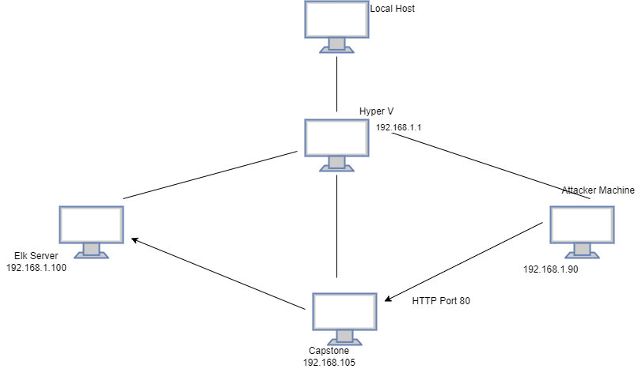
Network Topology
Network
Address Range:192.168.1.0/24
Netmask:255.255.255.0
Gateway:192.168.1.1
Machines
IPv4:192.168.1.1
OS:WINDOWS
Hostname:HYPER V
IPv4:192.168.1.100
OS: LINUX
Hostname: ELK
IPv4: 192.168.1.105
OS: LINUX
Hostname:CAPSTONE
IPv4:192.168.1.90
OS:KALI LINUX
Hostname:KALI

Slide 5

Red Team
Security Assessment
‹#›

Slide 6
Recon: Describing the Target
Nmap identified the following hosts on the network:
Hostname | IP Address | Role on Network
KALI | 192.168.1.90 | Attacker machine. This is used in finding vulnerabilities otherwise known as the Red Team attacker machine.
CAPSTONE | 192.168.1.105 | Victim machine. This is the machine which is using the apache. (vulnerable server)
ELK SERVER | 192.168.1.100 | This is used in recording logs/activities on the victim machine. Network monitoring machine which runs Kibana and logs data from capstone
HYPER V MANAGER | 192.168.1.1 | This is the Hosts to the entire Network.

Slide 7
Vulnerability Assessment
The assessment uncovered the following critical vulnerabilities in the target:
Vulnerability | Description | Impact
Data Exposure: sensitive information on public web server, enumeration is not blocked. Tools: nmap, dirb | The web server for the public websites should not contain internal data, even if password is protected. If port 80 is left open, it will allow public access. Ports respond to ping; can check for open ports and service versions. | Third parties can view information that should stay confidential known only to employees. Attackers are able to reveal leased IP addresses, view open ports and find hidden URL paths.
Brute Force Passwords Tool: Hydra | Sending many possible credentials to a login form simultaneously until a combination successfully logs in. | Third parties can crack the password and access the account. Affects confidentiality and integrity of data.
Unauthorized File Password: | Webdav allows anyone to write files to storage. ( it allows attackers to reveal the IP address and secret folder) | Third parties can upload and run scripts on a private server. Affects confidentiality and integrity. Attackers are able to reveal the IP address, sensitive and secret folder.
Remote Code Execution | Unauthorized scripts can run on the servers. Memory buffer overflow allows attackers to spawn a shell. | Provides access to file structure. Any command can be run. Affects confidentiality, integrity and availability.

Slide 8
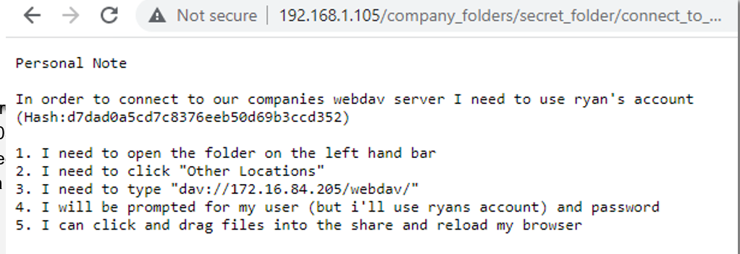
Exploitation: [nmap and Data Exposure.]
01
02
03
Tools & Processes
Tools that was used was the Nmap by running the command Nmap 192.168.1.100
-Hydra
Msfvenom
Achievements
I was able to determine that Port 80 was open on the victim's machine.

Slide 9
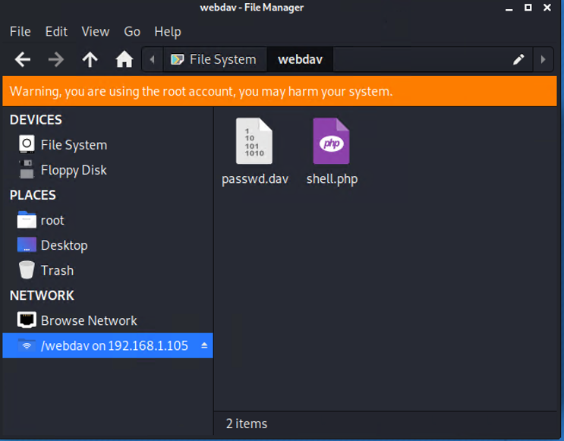
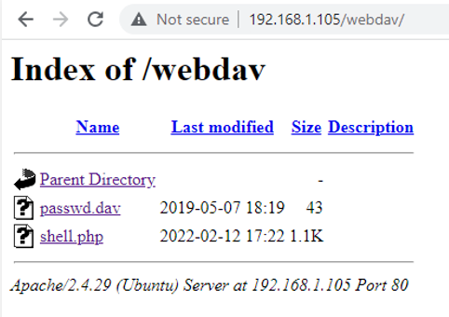
Exploitation: [File Upload Access]
01
02
03
Tools & Processes
How did you exploit the vulnerability? Which tool (Nmap, etc.) or techniques (XSS, etc.) did you use?
Achievements
What did the exploit achieve? For example: Did it grant you a user shell, root access, etc.?
[INSERT: screenshot or command output illustrating the exploit.]

Slide 10
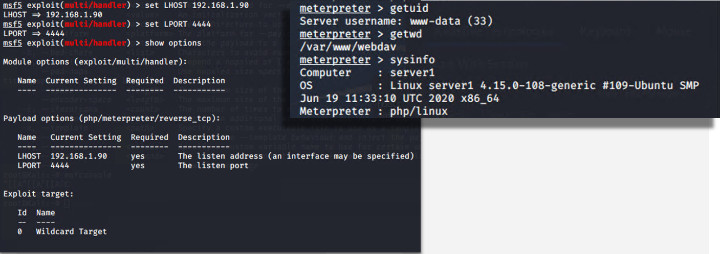
Exploitation: [Remote Code Execution.]
01
02
03
Tools & Processes
How did you exploit the vulnerability? Which tool (Nmap, etc.) or techniques (XSS, etc.) did you use?
Achievements
What did the exploit achieve? For example: Did it grant you a user shell, root access, etc.?
[INSERT: screenshot or command output illustrating the exploit.]

Slide 11

Blue Team
Log Analysis and Attack Characterization
‹#›

Slide 12
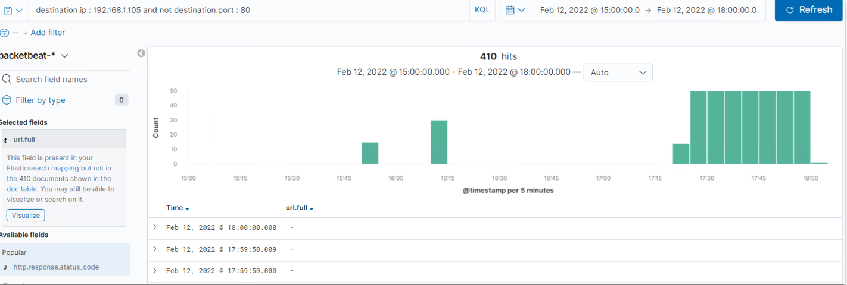

Analysis: Identifying the Port Scan
Answer the following questions in bullet points under the screenshot if space allows. Otherwise, add the answers to speaker notes.
What time did the port scan occur?
How many packets were sent, and from which IP?
What indicates that this was a port scan?
[Insert Here]
Include a screenshot of Kibana logs depicting the port scan.

Slide 13
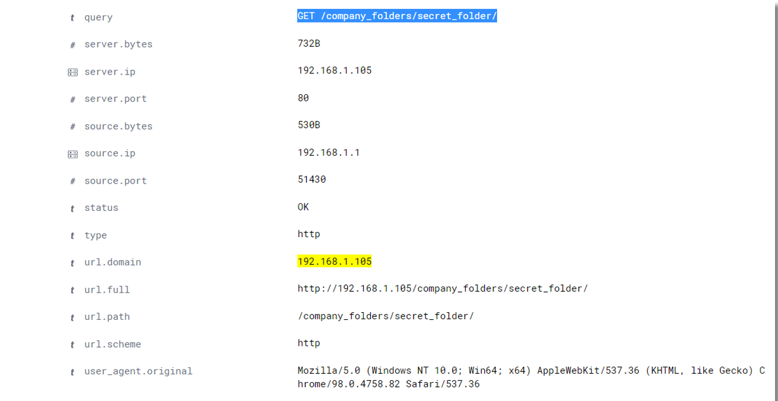
Analysis: Finding the Request for the Hidden Directory
Answer the following questions in bullet points under the screenshot if space allows. Otherwise, add the answers to speaker notes.
What time did the request occur? How many requests were made?
Which files were requested? What did they contain?
[Insert Here]
Include a screenshot of Kibana logs depicting the request for the hidden directory.

Slide 14
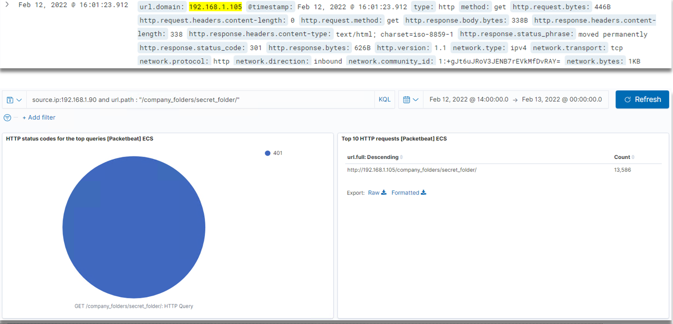
Analysis: Uncovering the Brute Force Attack
Answer the following questions in bullet points under the screenshot if space allows. Otherwise, add the answers to speaker notes.
How many requests were made in the attack?
How many requests had been made before the attacker discovered the password?
[Insert Here]
Include a screenshot of Kibana logs depicting the brute force attack.

Slide 15
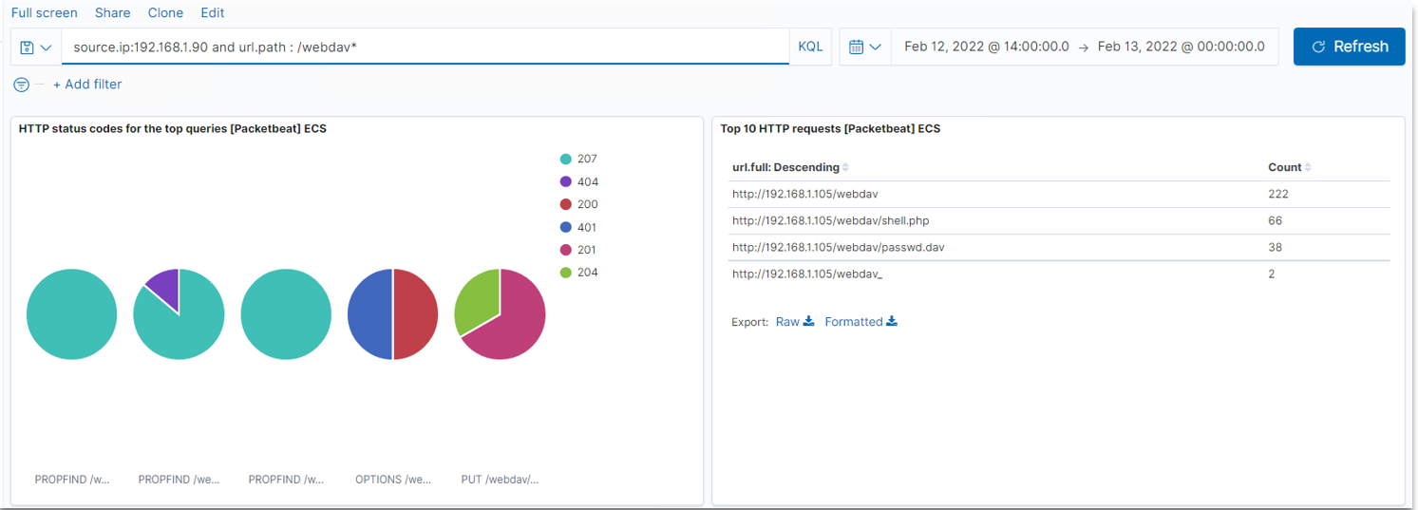
Analysis: Finding the WebDAV Connection
Answer the following questions in bullet points under the screenshot if space allows. Otherwise, add the answers to speaker notes.
How many requests were made to this directory?
Which files were requested?
[Insert Here]
Add a screenshot of Kibana logs depicting the WebDAV connection.

Slide 16
Blue Team
Proposed Alarms and Mitigation Strategies
‹#›

Slide 17
Mitigation: Blocking the Port Scan
Alarm upon incoming trafficking to destination ports are not normal. (80, 443, 22, etc).
Threshold:
Roughly 10-20 per hour. The odd packet to a strange port might be concerning, but traffic to many strange ports should alert the SOC.
Recommended configurations changes to mitigate port scans:
Deny all traffic on ports not required for the normal operations. Close the ports on the gateway/firewall.
Describe the solution. If possible, provide required command lines: Configure the gateway/firewall to close all ports, then open only the ports that are required.

Slide 18
Mitigation: Finding the Request for the Hidden Directory
Trigger alarm upon HTTP GET requests to /company_folders/secret_folder from a source IP that is not internal or otherwise approved.
Threshold:
Any requests from unauthorized sources are in question, thus 1. Only insiders should be aware that the secret folder exists.
Recommended configurations changes to block unwanted access:
Deny all request from unknown IP addresses.
Remove confidential files from servers that are open to public internet.
Command to remove the directory:
rmdir -r <hidden folder path>
Implement 2 FA to access the folder.

Slide 19
Mitigation: Preventing Brute Force Attacks
Trigger alert upon many 401 errors on the URL that includes /secret_folder/
Trigger alert upon requests from user. Agent = Hydra and other similar tools.
Threshold:
25 failed login attempts over one hour.
Dependant on webdav usage. More users, more failed logins.
Small company: 5
Medium business: 25
Enterprise: 50+
Recommended configuration changes to block brute force attacks:
Limit user access for five minutes after three failed login attempts.
Integrate a captcha or 2FA
Password complexity
Solution:
Blacklists IPs that trigger alerts in the future.
Review group policy for authentication (windows)
Configure the authentication policies to monitor and block multiple failed login from the same user.

Slide 20
Mitigation: Detecting the WebDAV Connection
What kind of alarm can be set to detect future access to this directory?
Alerts should be triggered anytime a foreign IP is trying to access these folders
What threshold would you set to activate this alarm?
Threshold should be set greater than 0 which will trigger the alert as capstone does not want external IPs connecting to the WebDAV directory.
What configuration can be set on the host to control access?
Restrict the IPs that can access this directory.
No connection should be allowed through port 80 to the WebDAV folder.
Create a firewall rule to allow whitelist IP address to access WebDAV directory.
Solution:
Implement 2FA authentication.
Block port 80 access to WebDAV directory.

Slide 21
Mitigation: Identifying Reverse Shell Upload.
Trigger alarm upon remote file upload file upload to a web server. Set alerts for any .php or .exe files that are being uploaded to server. Restrict access to certain IP addresses, trigger alert if any foreign external/unknown IP address is accessing the host.
Threshold should be 1, before alert is triggered. Scripts may have many files extensions or be hidden within other files, thus any files upload is suspicious.
Remove the ability to upload any files to directory via the web.
Allow only whitelist IPs write permission.
Enabling a signature on the IPs that detects and drops traffic with known Web Shell exploits.
Solution.
File content validation: block files that contain scripts.
Deny all uploads, ( no write permissions - read only)
Deny .php file extension upload attempts

Slide 22
Mitigation: Identifying Reverse Shell Uploads
What kind of alarm can be set to detect future file uploads?
Trigger alarm upon remote file upload file upload to a web server. Set alerts for any .php or .exe files that are being uploaded to server. Restrict access to certain IP addresses, trigger alert if any foreign external/unknown IP address is accessing the host.
What threshold would you set to activate this alarm?
Threshold should be 1, before alert is triggered. Scripts may have many files extensions or be hidden within other files, thus any files upload is suspicious.
What configuration can be set on the host to block file uploads?
Remove the ability to upload any files to directory via the web.
Allow only whitelist IPs write permission.
Enabling a signature on the IPs that detects and drops traffic with known Web Shell exploits.
Describe the solution.
File content validation: block files that contain scripts.
Deny all uploads, ( no write permissions - read only)
Deny .php file extension upload attempts

